Slide 1
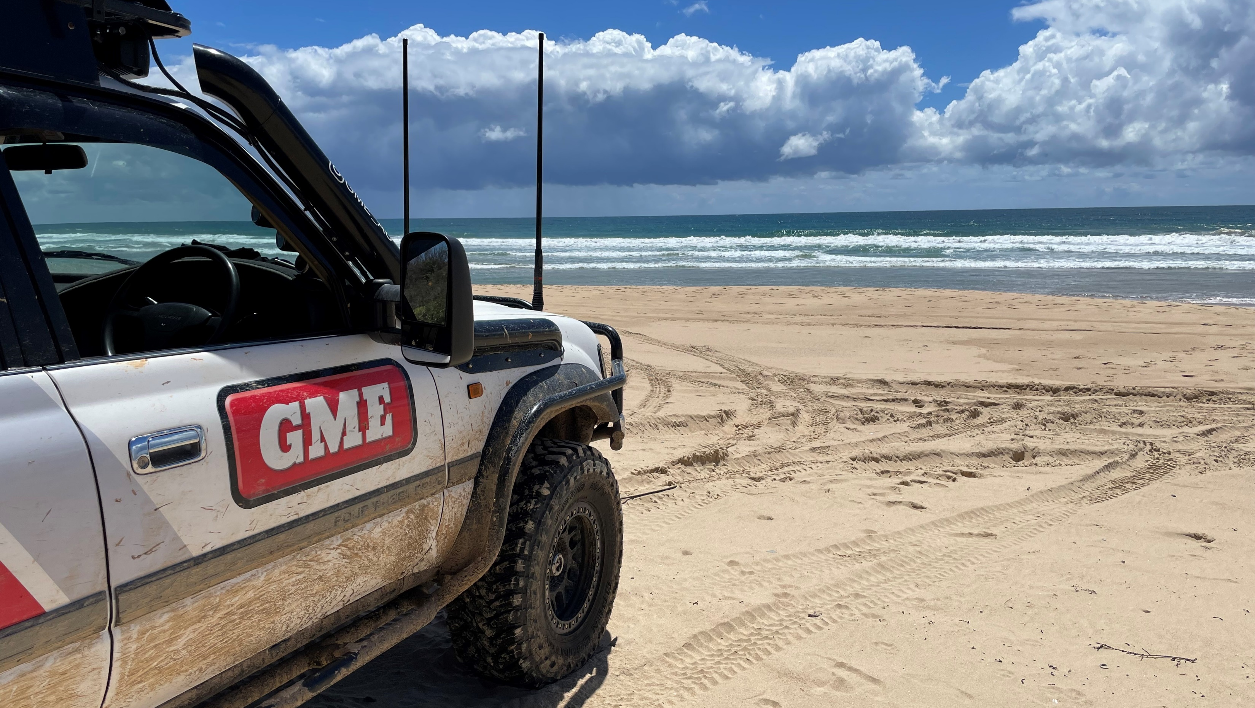
Heavy Duty All Terrain Pack (Multi-band Cellular) - AT4705BATP
10th October 2022
GME is proud to launch the newest addition to our AE4700 series of fiberglass radome antennas, the AT4705BATP. This Heavy-Duty Multi Band Cellular All Terrain Twin Pack is Australian designed and manufactured to meet the tough conditions of the Australian outback.
Our AT4704BA and AT4705BA are multiband cellular antennas with optimal performance to suit the 4G LTE networks found around the fringes of rural areas.
The AT4705BATP includes a combination of a shorter length whip with lower gain for mountainous terrain or built-up areas, and a longer length whip with higher gain for travelling on open roads or flat terrain.
GME has a specialised design team with the ability to develop application specific antenna products. With a purpose-built facility based in Sydney, GME continues our on-going commitment and dedication to local Australian manufacturing. Local manufacturing ensures GME is able to produce the highest quality communications equipment tailored to the harsh Australian landscape.
For more information, visit www.gme.net.au

Slide 2
Heavy Duty All Terrain Pack (Multi-band Cellular) - AT4705BATP
Key Specs
In the box
Interchangeable Whips
Black Fibreglass Radome
Heavy Duty Spring Base
Detachable Whip
Ground Independent Design
Pre-terminated SMA Connection
Covers 700, 850, 900 & 1800-2100MHz Cellular Bands
AW4704BCEL - 2.5dBi (700-900MHz) 5dBi (1800-2100MHz)
AW4705BCEL - 7dBi (700-900MHz) 2.5dBi (1800-2100MHz)
Length: 580mm / 1200mm
Antenna Whip (AW4704BCEL)
Antenna Whip (AW4705BCEL)
Heavy Duty Spring Base & Lead Assembly - SMA Connector (AS004BSCEL)
Model Code | AT4705BATP
Description | Heavy Duty All Terrain Pack (Multi-band Cellular)
EAN | 93 19493 31622 4
Country of Origin | Australia
Warranty | 1 Year
SRP | $439.00
Available From | 1st March 2023
Package Dimensions | 1330(H) x 125 (W) x 60 (D) mm – 2.22Kg
Our 1 year standard warranty

